Slide 1

Superman Application
Brief Overview of the Modules for TLM and above

Slide 2
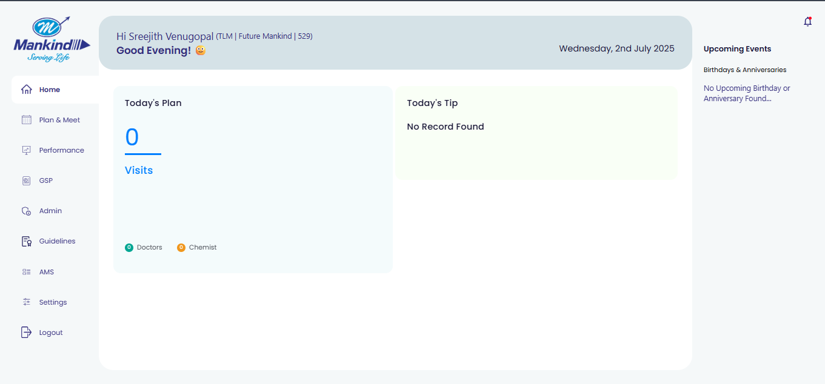
HOME SCREEN shows the planned customer and chemist calls as per the Tour plan
Upcoming events, notifications, and sync status can be checked on the home page as well
Since the manager only adds MR in JFW in TP, so it can show 0 planned visits even though TP is planned.
TLM - 10031417
PWD - Sree@62025

Slide 3
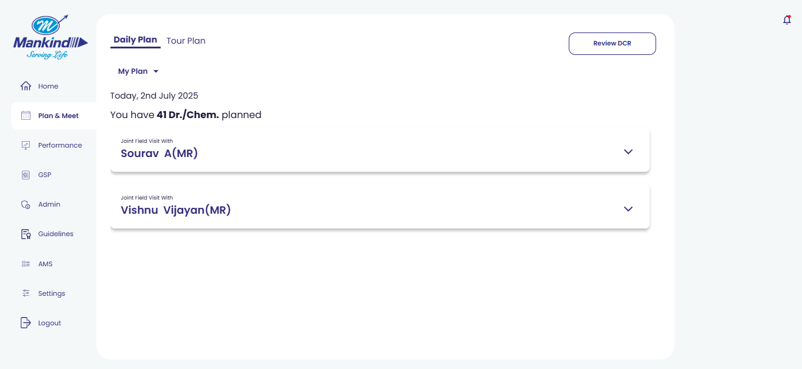
On the PLAN & MEET you will find options for daily plan and tour plan
The daily plan will show the planned customers and chemist calls for the selected MR or any individual activity planned
To plan DCR, you can click REVIEW DCR

Slide 4
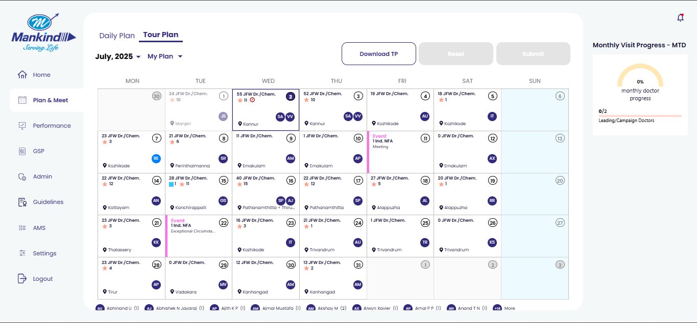
Tour plan shows the detailed planning for the month.
The TLM and above managers can plan their 6-month Tour plan in advance
The download TP option is available for TLM onwards managers

Slide 5
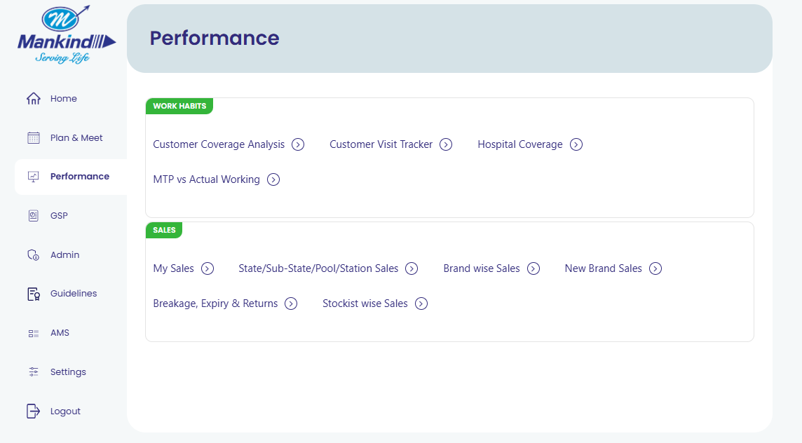
Performance Dashboard is for detailed reports of Customer & chemist coverage, and the sales report for the managers
They can check the leading customer coverage, JFW & TP deviation, and hospital coverage reports
Detailed sales dashboard according to geographies and Brands

Slide 6
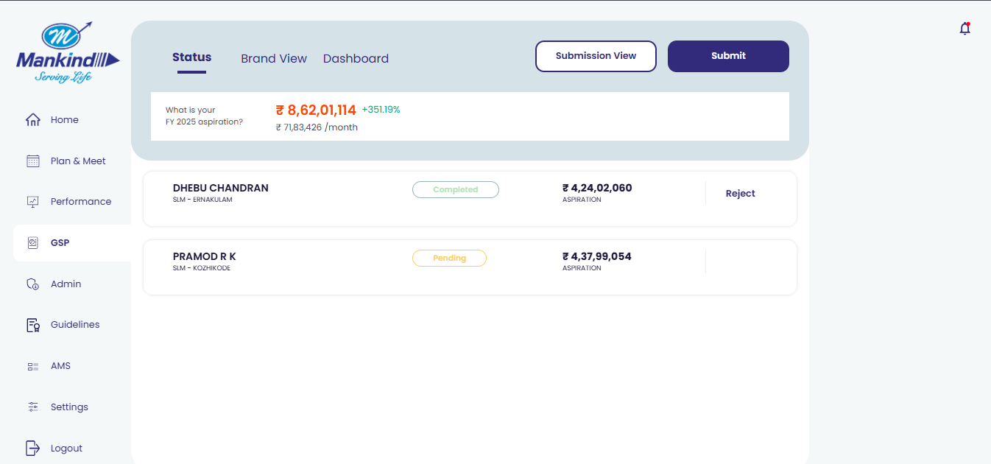
GSP module is for the Granular sales planning for the submitted for the upcoming financial year. It’s a once-in-a-year planning submitted at the start of every financial year

Slide 7
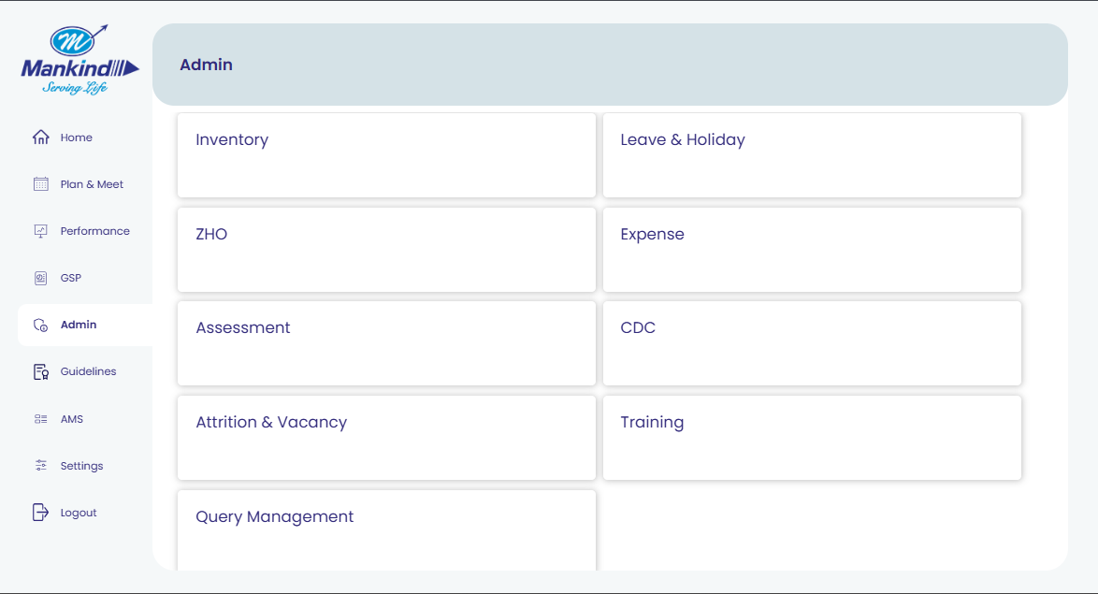
Admin option is for a variety of options related to the items and samples, leave, holiday etc.

Slide 8
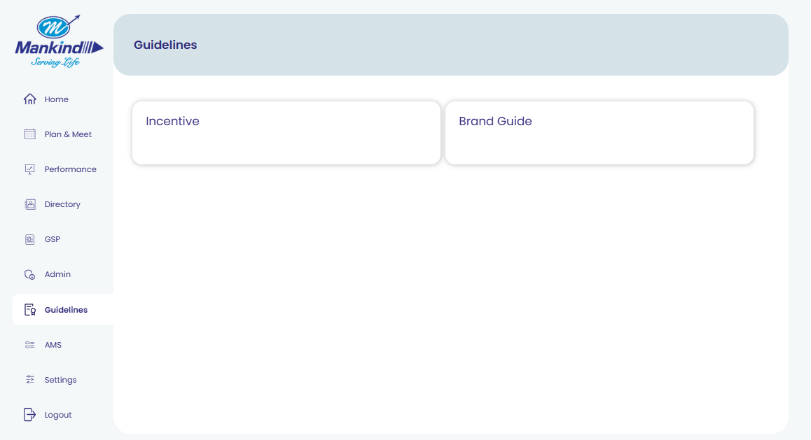
The Guidelines Module is for the Incentive policy and brand guide, updated by the admin

Slide 9
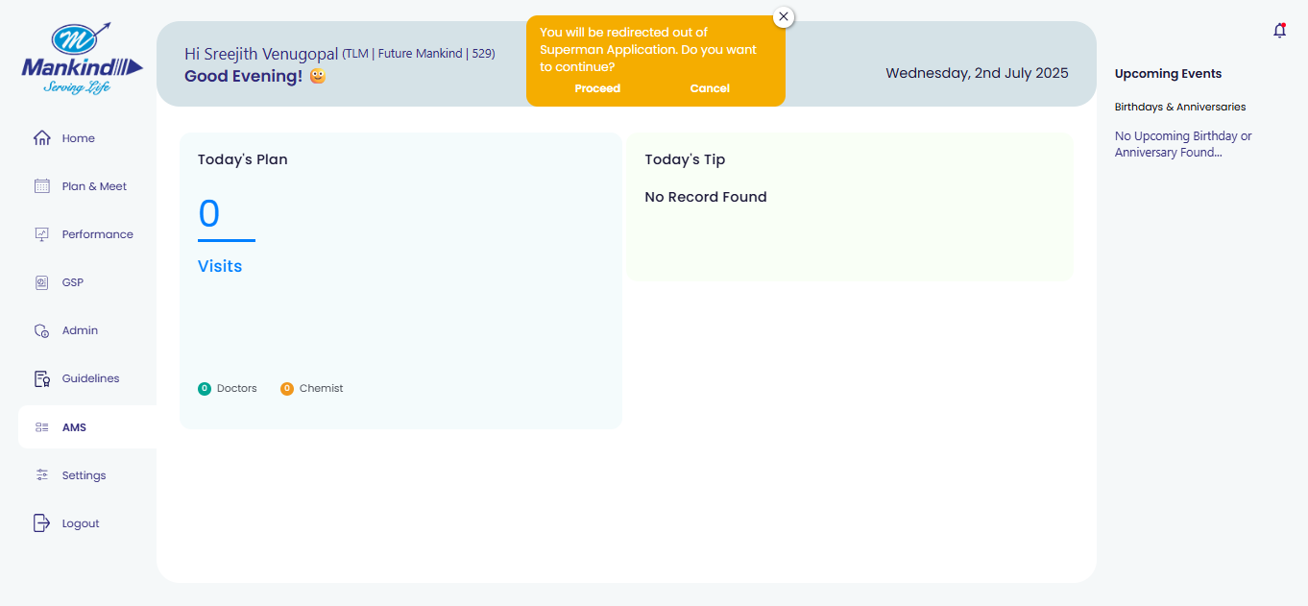
The AMS module redirects to the AMS production page if you click on proceed

Slide 10
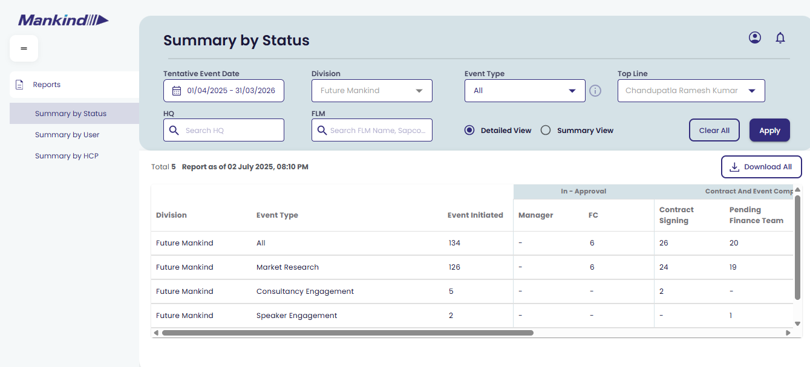
The AMS production landing page for the managers

Slide 11
Thank You!

